Slide 1

HEALTH INSURANCE DATASET VISUAL ANALYSIS
Presented by:
Zanis Ali
(B77407)
Presented To:
Jaak Vilo

Slide 2
Over view
Introduction
Dataset
Description and purpose of Dataset
Goals of the application
System Requirements
Visualization

Slide 3
introduction
I have done the Analysis of the health insurance marketplace, dataset from the U.S.A.
The dataset consists of health insurance and dental plans offered through healthcare (Government) between 2014 and 2016.
It encompasses rates for smokers and non-smokers, separately listed for each age group, benefits included in the different plans, states in which the plans were offered, and other information.
The dataset does not contain any information on actual purchases.
This application (Jupyter notebook) shows visualization of the dataset.

Slide 4
Dataset
Dataset of health insurance market place, which contain multiple files, but I took rate file for individual family and plan attributes to identify the plan types for analysis.
Rate file contains,
Rate file: rows - 1048576 and dimensions - 24 that makes our rate file (25, 165, 824),
plan attributes file : contains the rows - 77354 and dimensions=176 that makes our plan file (13,614,304).
Data set of 10.57 GB. 1627370 records were present in BenefitsCostSharing.csv, 12694445 records were present in Rate.csv and 77353 records were present in PlanAttributes.csv.
Thus, I have done analysis on huge amount of data.
The data set is also divided based on year and the data is given for each year.

Slide 5
Description and purpose of dataset
This data which is used is from the Centers for Medicare & Medicaid Services (CMS).
In the Rate csv file - This csv describes the variables contained in the Rate-PUF. Each record relates to one issuer’s rates based on plan, geographic rating area, and subscriber eligibility requirements.
The RatePUF is available for plan year 2014, plan year 2015, and plan year 2016. Each record relates to the coverage of a single benefit by one issuer’s insurance plan.

Slide 6
Goals of the application
VISUALIZATION:
Map for the registered states in Health Insurance Marketplace
Box Plot for the individual rates by state
Year rate analysis
MACHINE LEARNING:
PCA ( Principle Component Analysis)

Slide 7


System requirements
Software’s:
Platform - Anaconda
Jupyter Notebook
Libraries [Plotly and seaborn]
Language - Python
Hardware:
RAM – 8GB
Hard disk – 20GB
Operating System – Windows 10

Slide 8
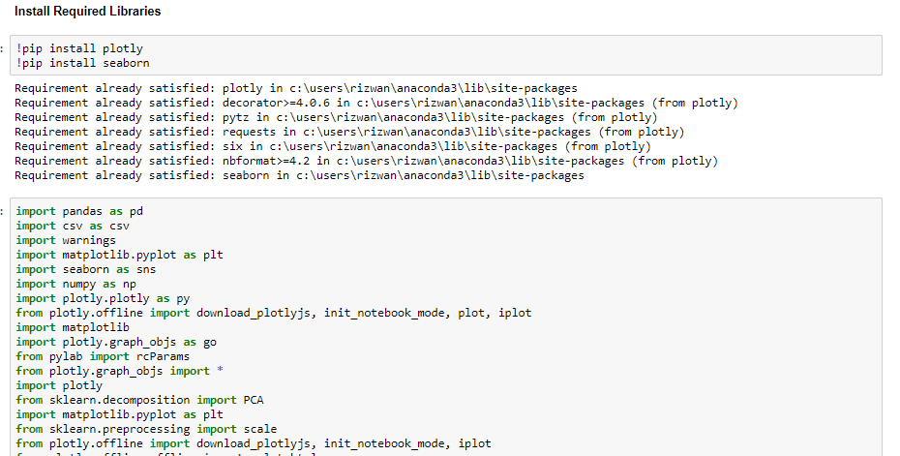
Plotly and Seaborn

Slide 9
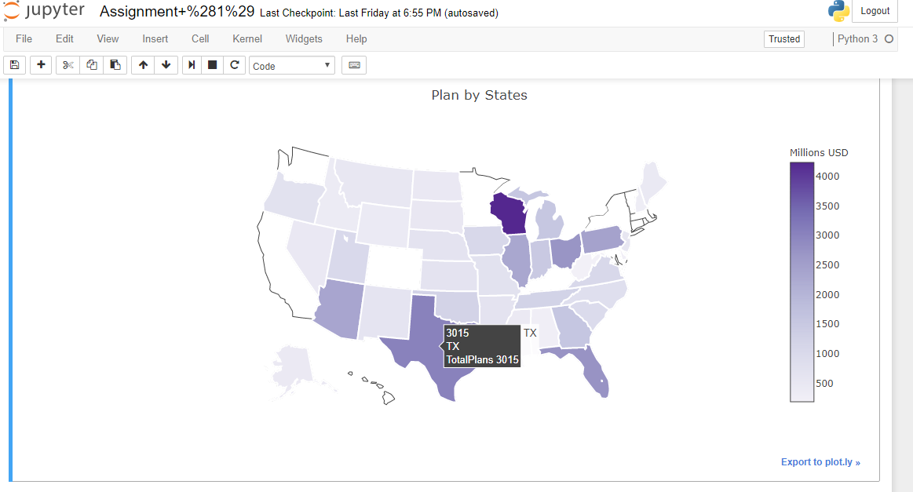
Visualization and interaction
Exploration of Number of plans by States (Choropleth Plot) : (Analysis)
This choropleth map shows the number of Medical plans state wise.
Darker the shade more is the number of plane of the state and vice versa.
Thus on exploration we can see that States like WI, TX have a plan more than 4000.

Slide 10
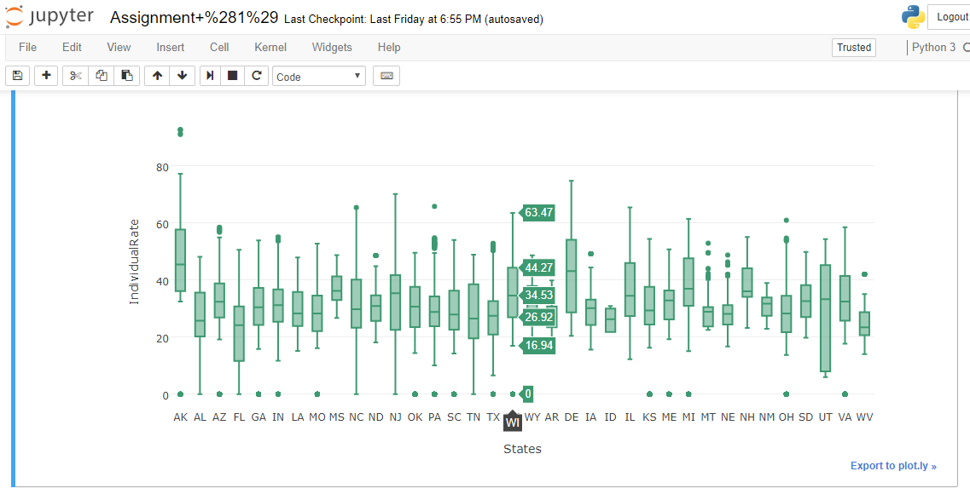
Individual Rates By State: (Analysis)
This box plot map shows individual rates state wise.
Higher the box then higher the rate for that state.
Thus on exploration we can see that States like AK,DE have most expensive plans for insurance but states like UT have maximum number of plans.

Slide 11
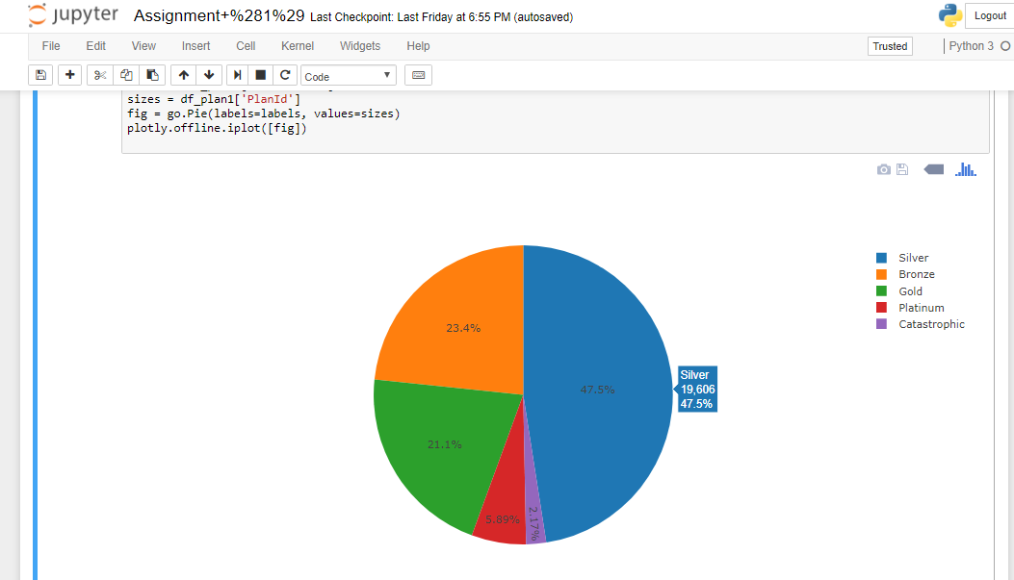
Types of Insurance Plans: Analysis
This Pie chart shows types of insurance plans.
Mostly peoples takes silver plans and Bronze.
This shows that these plans are cheap so mostly people take these types of plans.

Slide 12
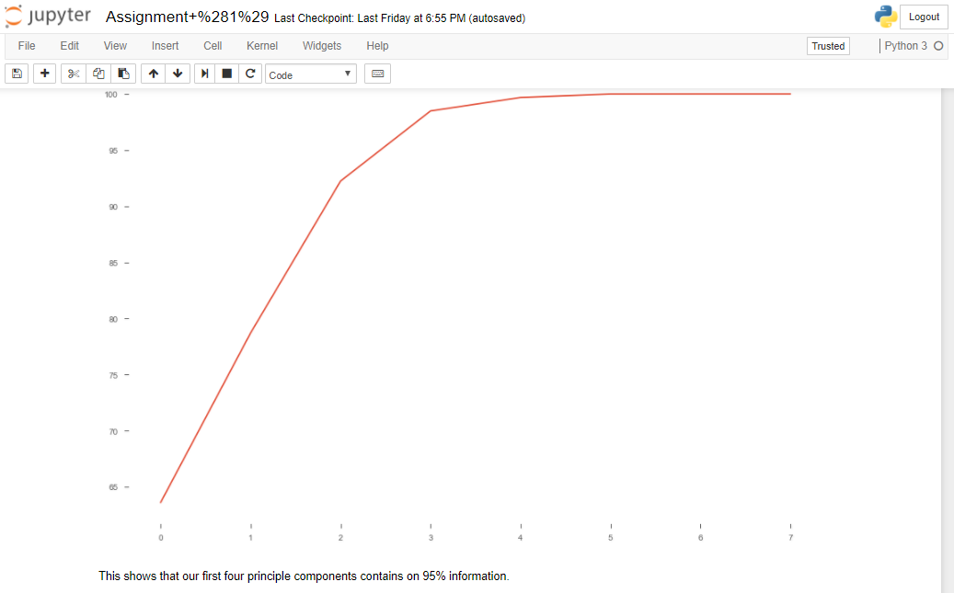
Algorithm (PCA - Principle Component Analysis)
Analysis:
After sorting the eigenpairs, the next question is “how many principal components are we going to choose for our new feature subspace?” A useful measure is the so-called “explained variance,” which can be calculated from the eigenvalues.
The explained variance tells us how much information (variance) can be attributed to each of the principal components.
Note: Used rate file to get variance between rate and to find the most import fields of rates.

Slide 13
Source
DATASET:
https://www.kaggle.com/hhsgov/health-insurance-marketplace
Analysis Research/Understanding:
Domain: Health Insurance domain.
https://www.healthcare.gov/glossary/ - The glossary has a list of health insurance.
https://www.cms.gov/CCIIO/Resources/Data-Resources/Downloads/2-General_Information_Factsheet- 05032016_draft.pdf - This document outlines important information about the Health Insurance Marketplace Public Use Files (Marketplace PUF), including source data, file size, variables, key assumptions, analytic utility, and support information. A data dictionary is also available for each of the separate files within the Marketplace PUF.
http://www.ixshealth.com/ - In this website we got to know what kind of insurance are present in the market and who can use with which health insurance plans.

